Slide 1
DY23-07: EcoFOCI Spring Larval Survey
MISSION: 35 year survey to estimate the abundance, transport, and other factors influencing the survival of larval fish walleye pollock and other species of commercial importance.
MISSION: Continue 35 year time series of environmental and biological conditions in Shelikof Strait at Line 8 (not accomplished)
MISSION: contributed real-time data in the form of rapid counts of zooplankton and icthyoplankton for spring PEEC meeting, along with Ecosystem Status Report for end of year PFMC meeting
Sampling: zooplankton and icthyoplankton net sampling (bongos & CalVETs) & physical oceanography (CTDs)
Recent surveys have gone from 21 DAS to 12 DAS
Chief Scientist duties: months of planning & organization: crew, project instructions, gear shipping, travel, etc.
Scheduled DAS: 5/14 – 5/25/2023
Actual DAS: 5/15 – 5/22/2023 (2 weather delays, 3 crew issues)

Slide 2
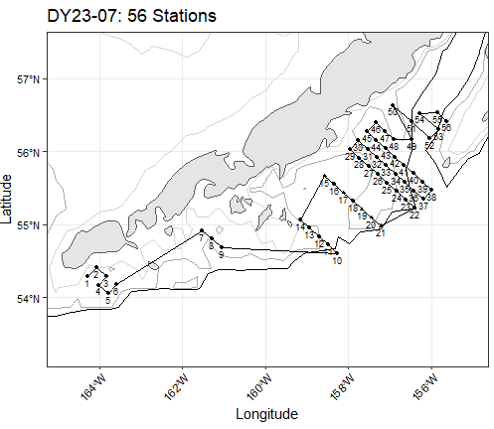
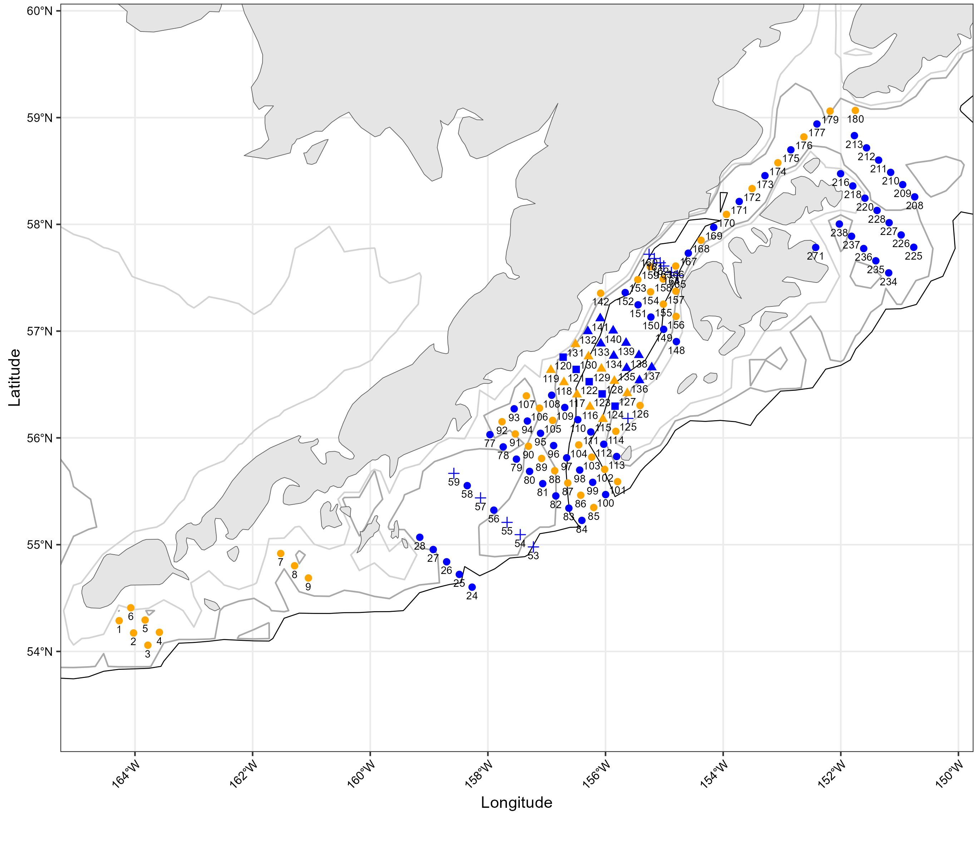
DY23-07: Pre-Survey Station Grid
Pre-Survey: estimated around 140 stations possible, 120 likely w/ estimated weather delays
Post Survey: 56 stations completed, yet station sampling plan could have been altered with better communication from crew (core grid could have been completed)

